Slide 1
Week 7 Collections
Note: this presentation should be viewed in presenter mode as it contains quite a few animations. It’s been configured to present in windowed mode so you can view it alongside your other windows
Dr Lewis Evans
Email: L.Evans@mmu.ac.uk
Office: E112
Office Hours:
Thursday: 10-11am
Friday: 9-11am

Slide 2


Outline
Collections
Arrays
ArrayLists

Slide 3

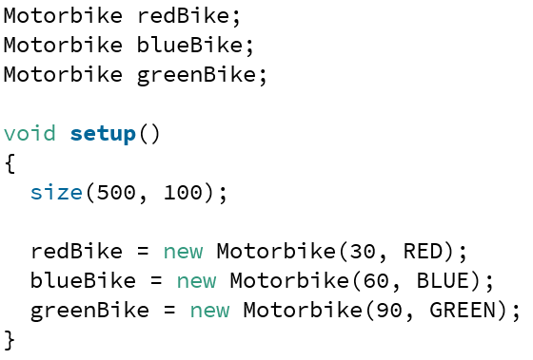
Collections
We have written quite a few programs now that have had many things in them
We have been using individual variable names to refer to these (e.g. redBike or bike1)

Slide 4
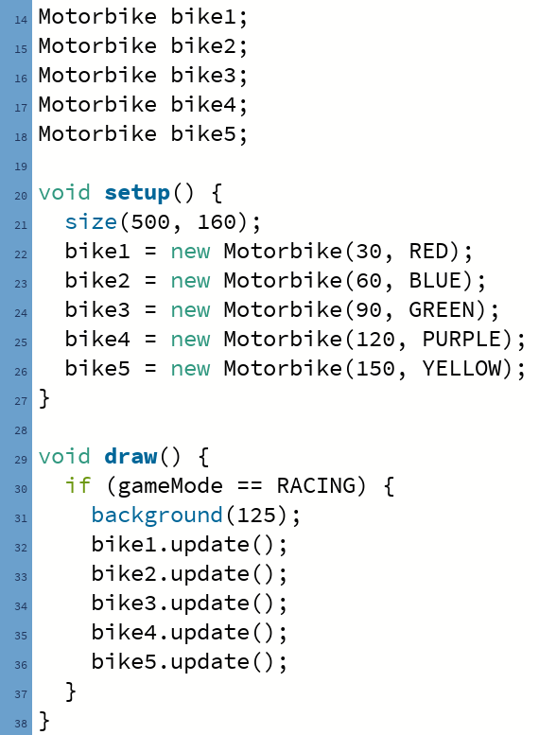
Collections
This is fine, but what if we need hundreds or thousands of objects of the same type (e.g. 1000s of motorbikes)?
We could make lots of individually named objects (see right)
But this is clearly not a very good approach – each thing would result in more lines of code

Slide 5
Collections
What we need is a way to easily create and bunch together a large number of things of the same type
We can then iterate over them and perform tasks (e.g. tell every alien object we have to update)
Iterate over – visit each one of a collection in turn
The simplest collection available in Java (and most languages) is the Array
An array is simply “an arrangement of similar objects”

Slide 6
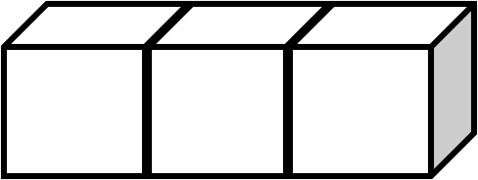
Arrays
Before we look at an array of objects (e.g. aliens, motorbikes), it would be helpful to look at a basic array that just contains integers to get familiar with the terminology
The values in an array are referred to as elements
Elements must all be of the same type
This array contains 10 elements which are integers
Values
24 | 2 | 3 | 6 | 147 | 0 | -14 | 16 | 99 | -100

Slide 7
Arrays
Each value (element) in an array can be referenced through its index, which is of type int
Arrays are zero-based in Java – the first element is located at index 0
Index
0 | 1 | 2 | 3 | 4 | 5 | 6 | 7 | 8 | 9
Values
24 | 2 | 3 | 6 | 147 | 0 | -14 | 16 | 99 | -100

Slide 8
Arrays
All of the elements in an array are stored in one contiguous block in memory
Since ints are 4 bytes:
Index
0 | 1 | 2 | 3 | 4 | 5 | 6 | 7 | 8 | 9
Values
24 | 2 | 3 | 6 | 147 | 0 | -14 | 16 | 99 | -100
Memory location
1000 | 1004 | 1008 | 1016 | 1020 | 1024 | 1028 | 1032 | 1036 | 1040

Slide 9

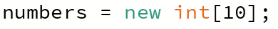
Arrays
Creating an array is a two step process
Declare what data type the array will “hold”, followed by square brackets [ ] and give the array a name
Then we construct it using the array constructor (new keyword), telling it how many elements we want
Or we can combine the declaration and initialisation in one line

Slide 10
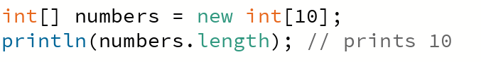
Arrays
Once an array has been allocated memory, it is of fixed size
Every array ‘knows’ its size through a length variable (accessed via arrayName.length)
Creating an array using the constructor (new keyword) causes an array to be created and filled with default values
0 for numeric types, false for boolean, null for objects
We can access the individual elements of an array by index using square brackets:
numbers[0] = 14;
numbers[3] = 21;
0 | 1 | 2 | 3 | 4 | 5 | 6 | 7 | 8 | 9 | Index
 | 0 | 0 |  | 0 | 0 | 0 | 0 | 0 | 0 | Value
0
0
14
21

Slide 11
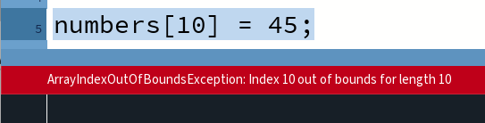
Arrays
Arrays have a lower and upper bound (indices we are able to access)
The lower bound is the first element (index 0)
The upper bound is the last element (arrayName.length – 1)
Attempting to access an index that does not exist causes an exception (an error in our code causing it to crash)
Many types of exceptions (see more later in the unit)
ArrayIndexOutOfBounds – referencing an index that does not exist
0 | 1 | 2 | 3 | 4 | 5 | 6 | 7 | 8 | 9 | Index
 | 0 | 0 |  | 0 | 0 | 0 | 0 | 0 | 0 | Value
14
21

Slide 12
Arrays
We can have arrays that store primitive types or reference (object) types – but what’s the difference?
Types in Java
Primitive Types
Class Types
boolean
Numeric
Classes defined for us (e.g. in Processing or Java library)
Classes we define
Integers
Motorbike
Floating-point
PImage
char
Alien
String
byte
long
thousands of others
Student
float
double
short
int

Slide 13
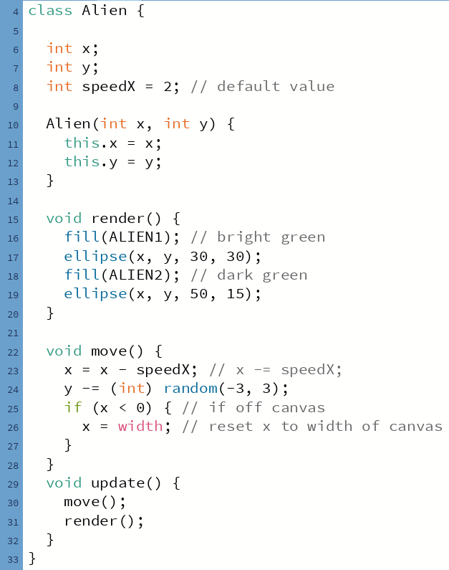
Arrays
Let’s now look at how an array of objects works, using the Alien class we saw last week
This Alien class has:
3 variables: x, y, speedX
An constructor (which must be provided two integers to initialise the x and y)
3 methods:
render – renders the alien
move – moves the alien
update – calls move and render

Slide 14
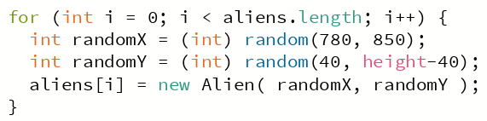
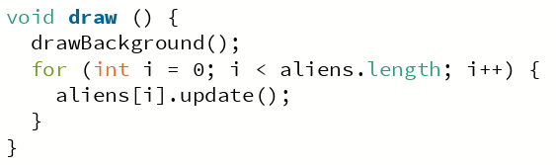
Array of Objects
We don’t have any alien objects yet – just an array that is capable of holding references to three alien objects
Index | 0 | 1 | 2
Value
Outside of setup/draw – create array of Aliens
0
1
2
i
3
Inside setup – create alien objects
aliens[0]
aliens[1]
aliens[2]
x
817
x
789
x
833
y
79
y
312
y
231
speedX
2
speedX
2
speedX
2
Inside draw – iterate through array
Note: x and y are generated randomly – so x/y values here are assumed

Slide 15
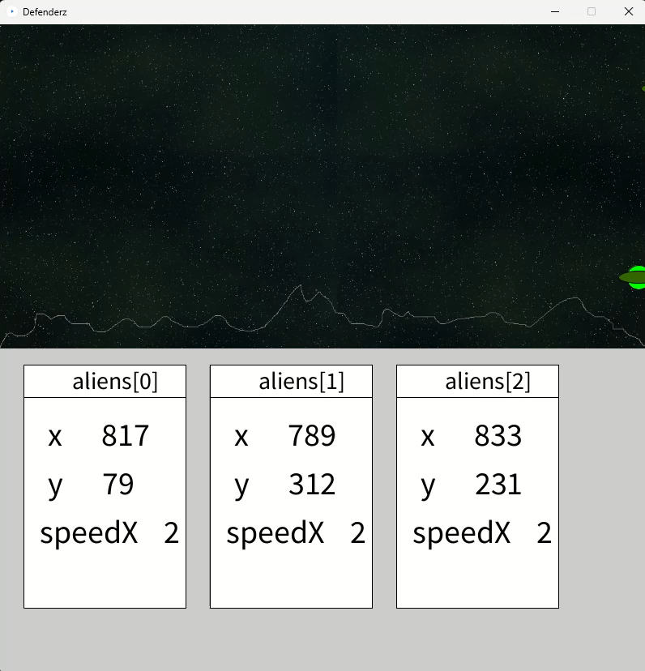
Arrays of Objects

Slide 16
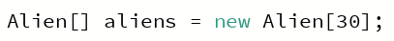
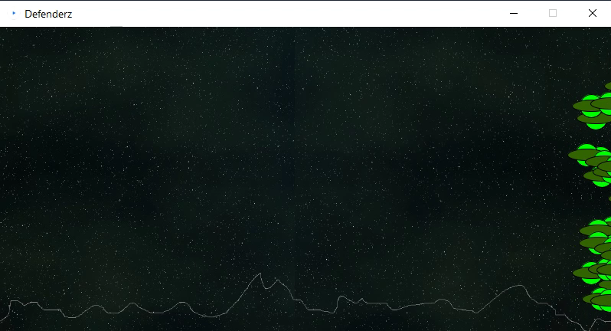
Arrays
Although that array only had 3 aliens in it, the same process of creating alien objects to “fill up” the array, and iterating through the array to call the update method will be followed whether the array has 3 objects or..
30 Alien objects

Slide 17
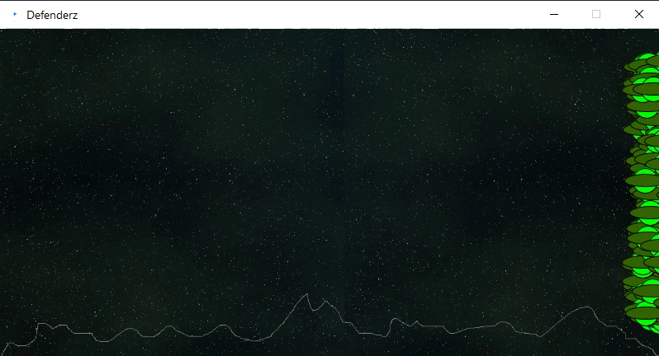
Arrays
Or 300 Alien objects..

Slide 18
Arrays
Arrays are great – we can create lots of things of the same type and they are stored together – whether those things are simple types like ints or more complex types like objects
As we just saw, an array of objects is really just an array of references that point to those objects
One of the limitations of arrays is that they are of fixed size – they cannot grow or shrink at runtime if you suddenly decide you want to store more things
Java provides a collection that can grow/shrink during runtime – ArrayList
Provides more flexibility – we can add objects to the collection as the program is running

Slide 19
ArrayLists
Let’s look at the syntax for creating and using an ArrayList
Syntax:
ArrayList<ClassName> listName = new ArrayList<ClassName>();
Providing the class name a second time in the <> brackets is optional

Slide 20
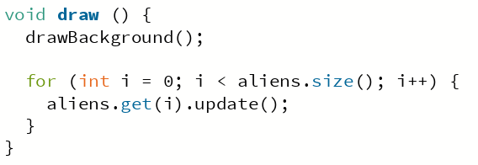
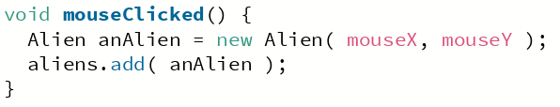
ArrayLists
In this example, we are going to add a new Alien to an ArrayList every time the user clicks the mouse – the x and y of the new alien will be determined by the mouseX and mouseY variables
Outside of setup/draw – create ArrayList of Aliens
Inside draw – iterate through ArrayList
size() method gives number of items
get() method returns the item at the specified index in the list
Inside mouseClicked – add an alien

Slide 21
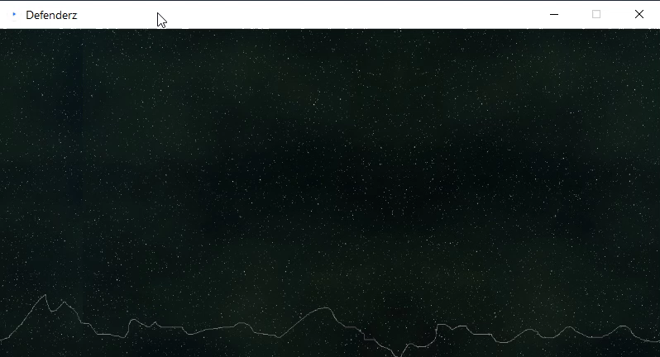
ArrayLists

Slide 22
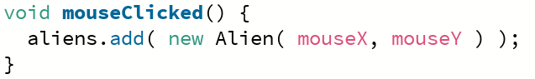
ArrayLists
When adding something to our ArrayList, instead of creating an object and assigning it to a variable, like we are doing below:
We can just create an object as we are adding it to the array, like so:
This is called an anonymous object – it’s anonymous because it doesn’t have a named reference associated with it

Slide 23
ArrayLists – helpful methods
We’ve just seen a few helpful methods of the ArrayList class on a previous slide
add( item );
Adds an item to the end of the ArrayList
There is another version of this method – add(index, item); adds an item at the specified index
get( index );
gets an item at the specified index
size();
Returns the size of the ArrayList as an integer
This is different to how we would find out the length of a normal array, which uses the length property (no parentheses () )
We will get some more practice using collections in the next two webinars and in next week’s lab (Week 8)

Slide 24
ArrayLists – removing items from an ArrayList
Another helpful method of the ArrayList class is remove( index );
This allows us to specify an item that should be removed from the ArrayList
Let’s assume we have an ArrayList with 4 alien objects already inside it – accessible from indices 0-3
aliens.remove(1);
Index
0
1
2
3
aliens
ArrayList
Value
aliens[0]
alien obj
aliens[1]
aliens[2]
aliens[3]

Slide 25
ArrayLists – removing items from an ArrayList
Another helpful method of the ArrayList class is remove( index );
This allows us to specify an item that should be removed from the ArrayList
Let’s assume we have an ArrayList with 4 alien objects already inside it – accessible from indices 0-3
aliens.remove(1);
The item is removed – as is the reference that was pointing to the object
Everything to the right moved along to ‘fill the gap’
The alien object that no longer has a reference to it will become garbage collected
Index
0
1
2
aliens
ArrayList
Value
aliens[0]
alien obj
aliens[1]
aliens[1]
aliens[2]
aliens[2]
aliens[3]

Slide 26
ArrayList vs Array
If an ArrayList offers us the flexibility of continuously adding things to it, why would we ever bother with having a fixed-size array?
Arrays being fixed-size offer us some benefits
Makes it clear in the code how many things are going to be inside the array
More efficient – Java can request the exact amount of memory it requires to store the things inside the array
An ArrayList, on the other hand, will need to repeatedly request more memory from the Operating System as things are added
(the ArrayList won’t communicate to the OS directly – there is something called the Java Virtual Machine that operates behind-the-scenes to make our lives easier)

Slide 27



Summary
Collection - A “systematic arrangement of things”
Those things could be primitive types (e.g. int, float), or objects (e.g. Alien, Motorbike)
In the case of objects, a collection will store the references to the objects – not the objects themselves
Array – fixed-size data structure
ArrayList – dynamic data structure that can grow/shrink as the program is running
Good luck with your test this week!

